Slide 1
Meeting notes 03.09.

Slide 2
Constraints:
Obstacle constraint (alread implemented)
Bounding box constraints
Fix point contraint
3D object penetration constraints
Length constraints – still difficult
General approach – enforce constraints with forces during inference

Slide 3
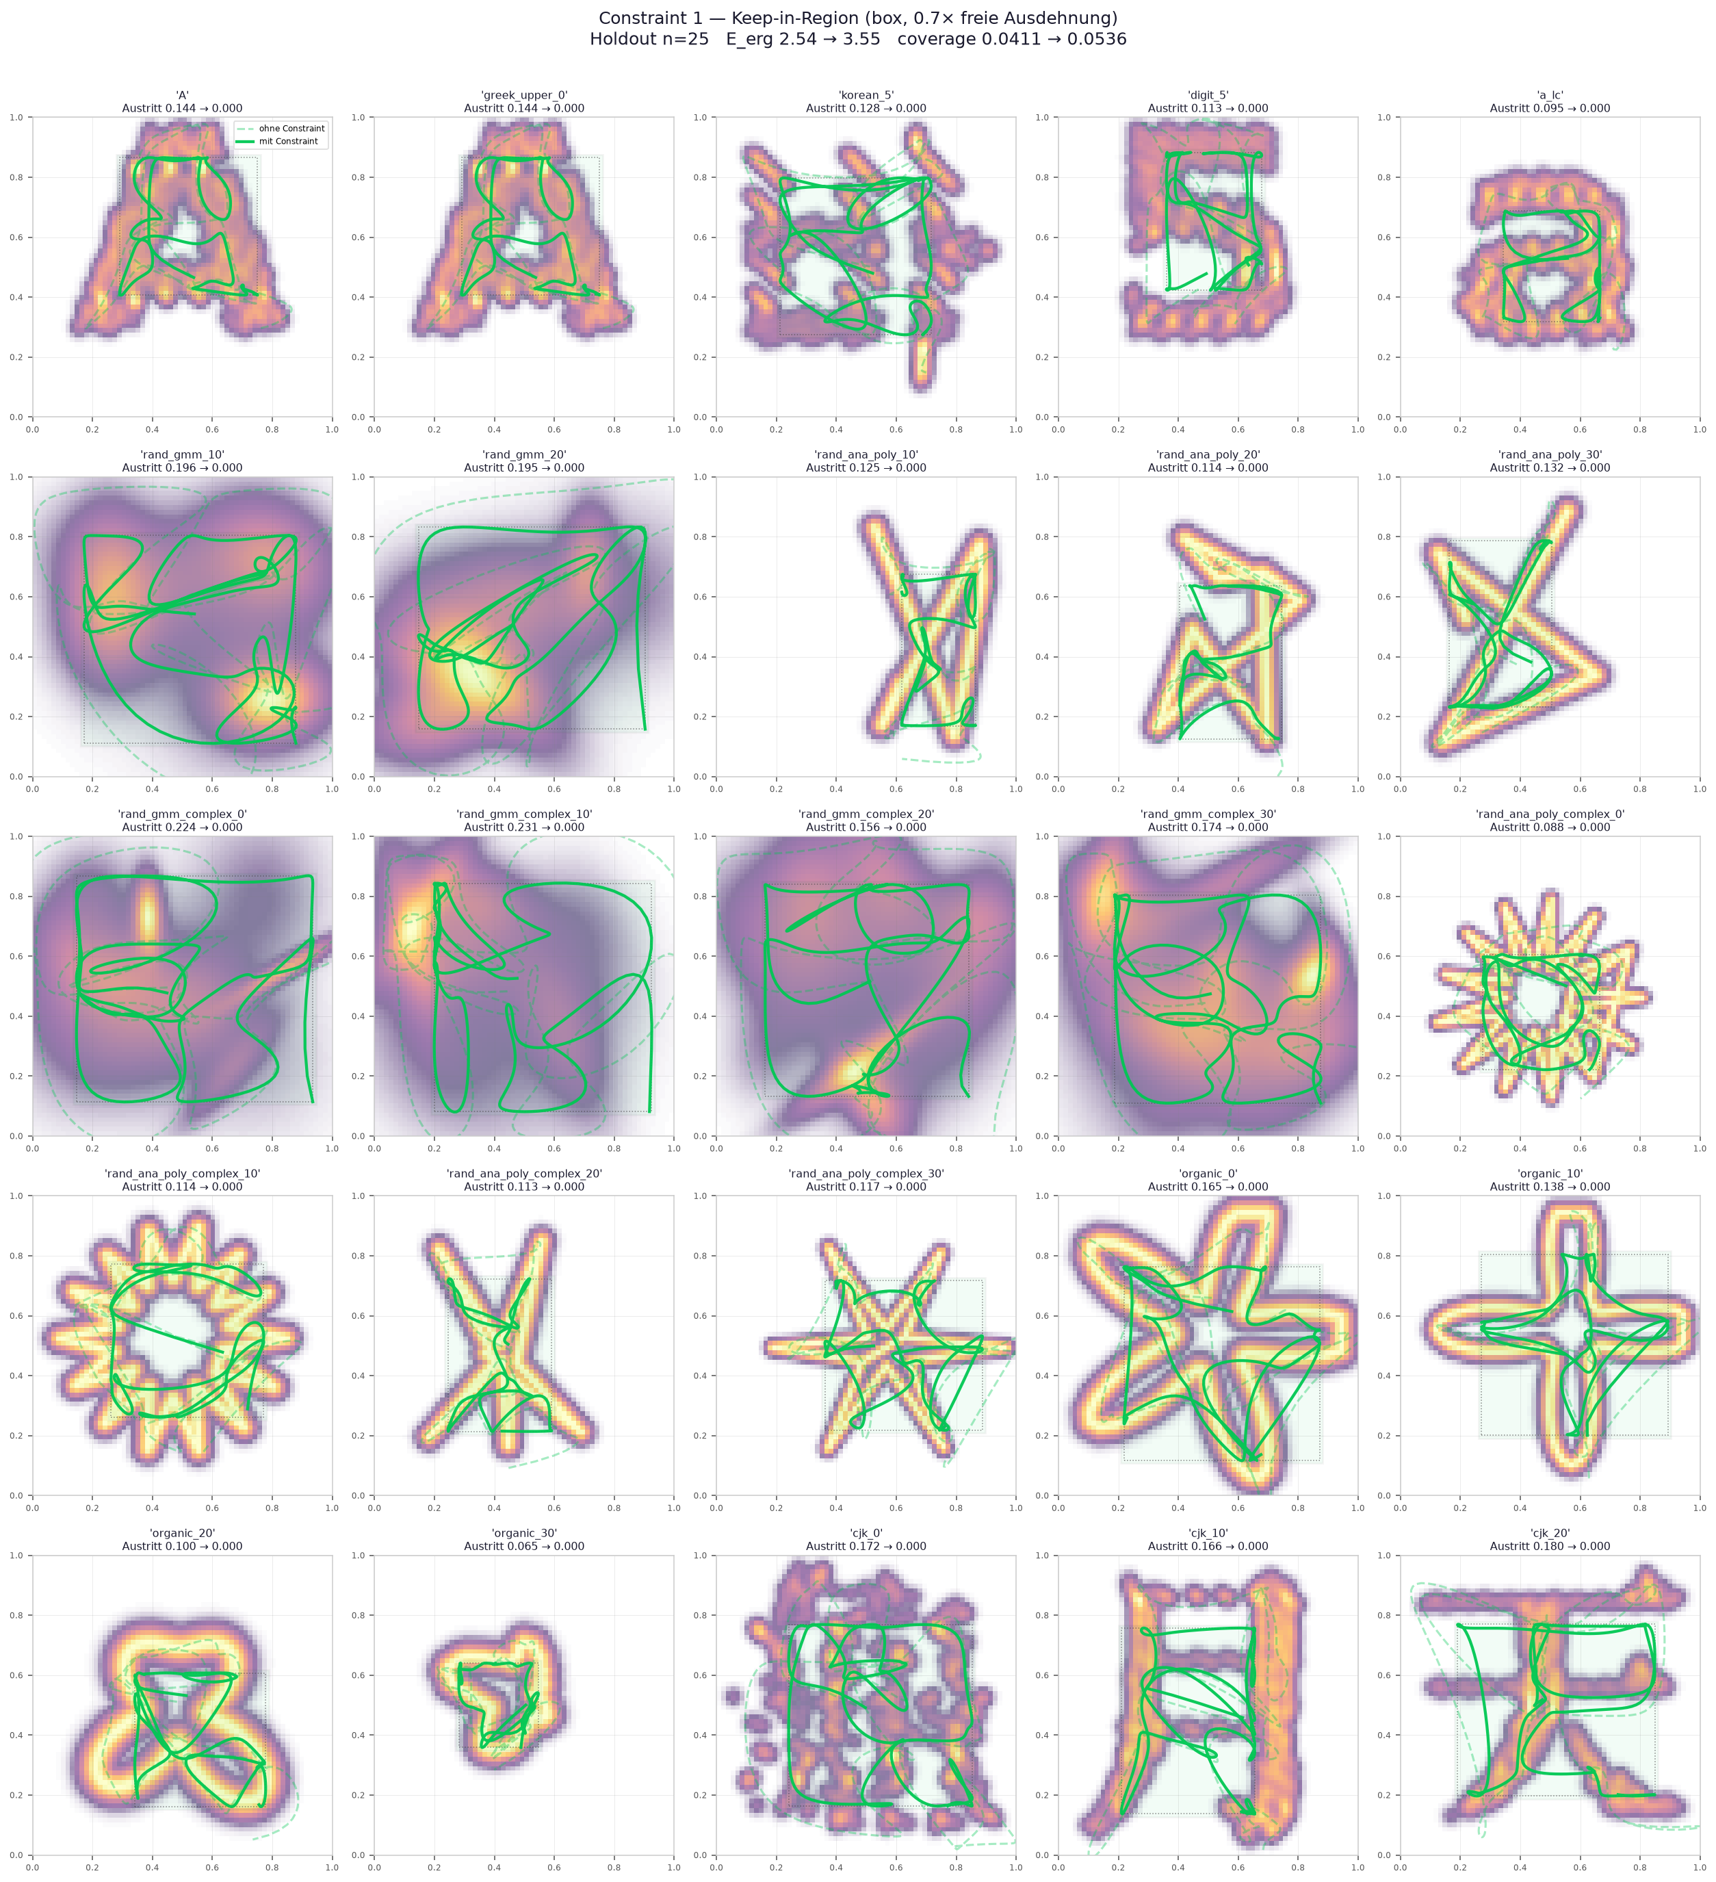
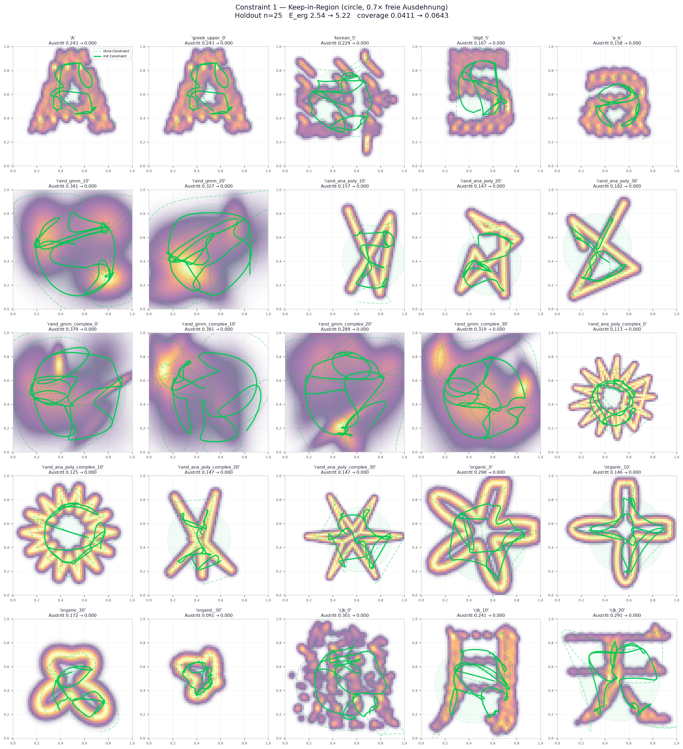
Constraints: Bounding box constraints

Slide 4
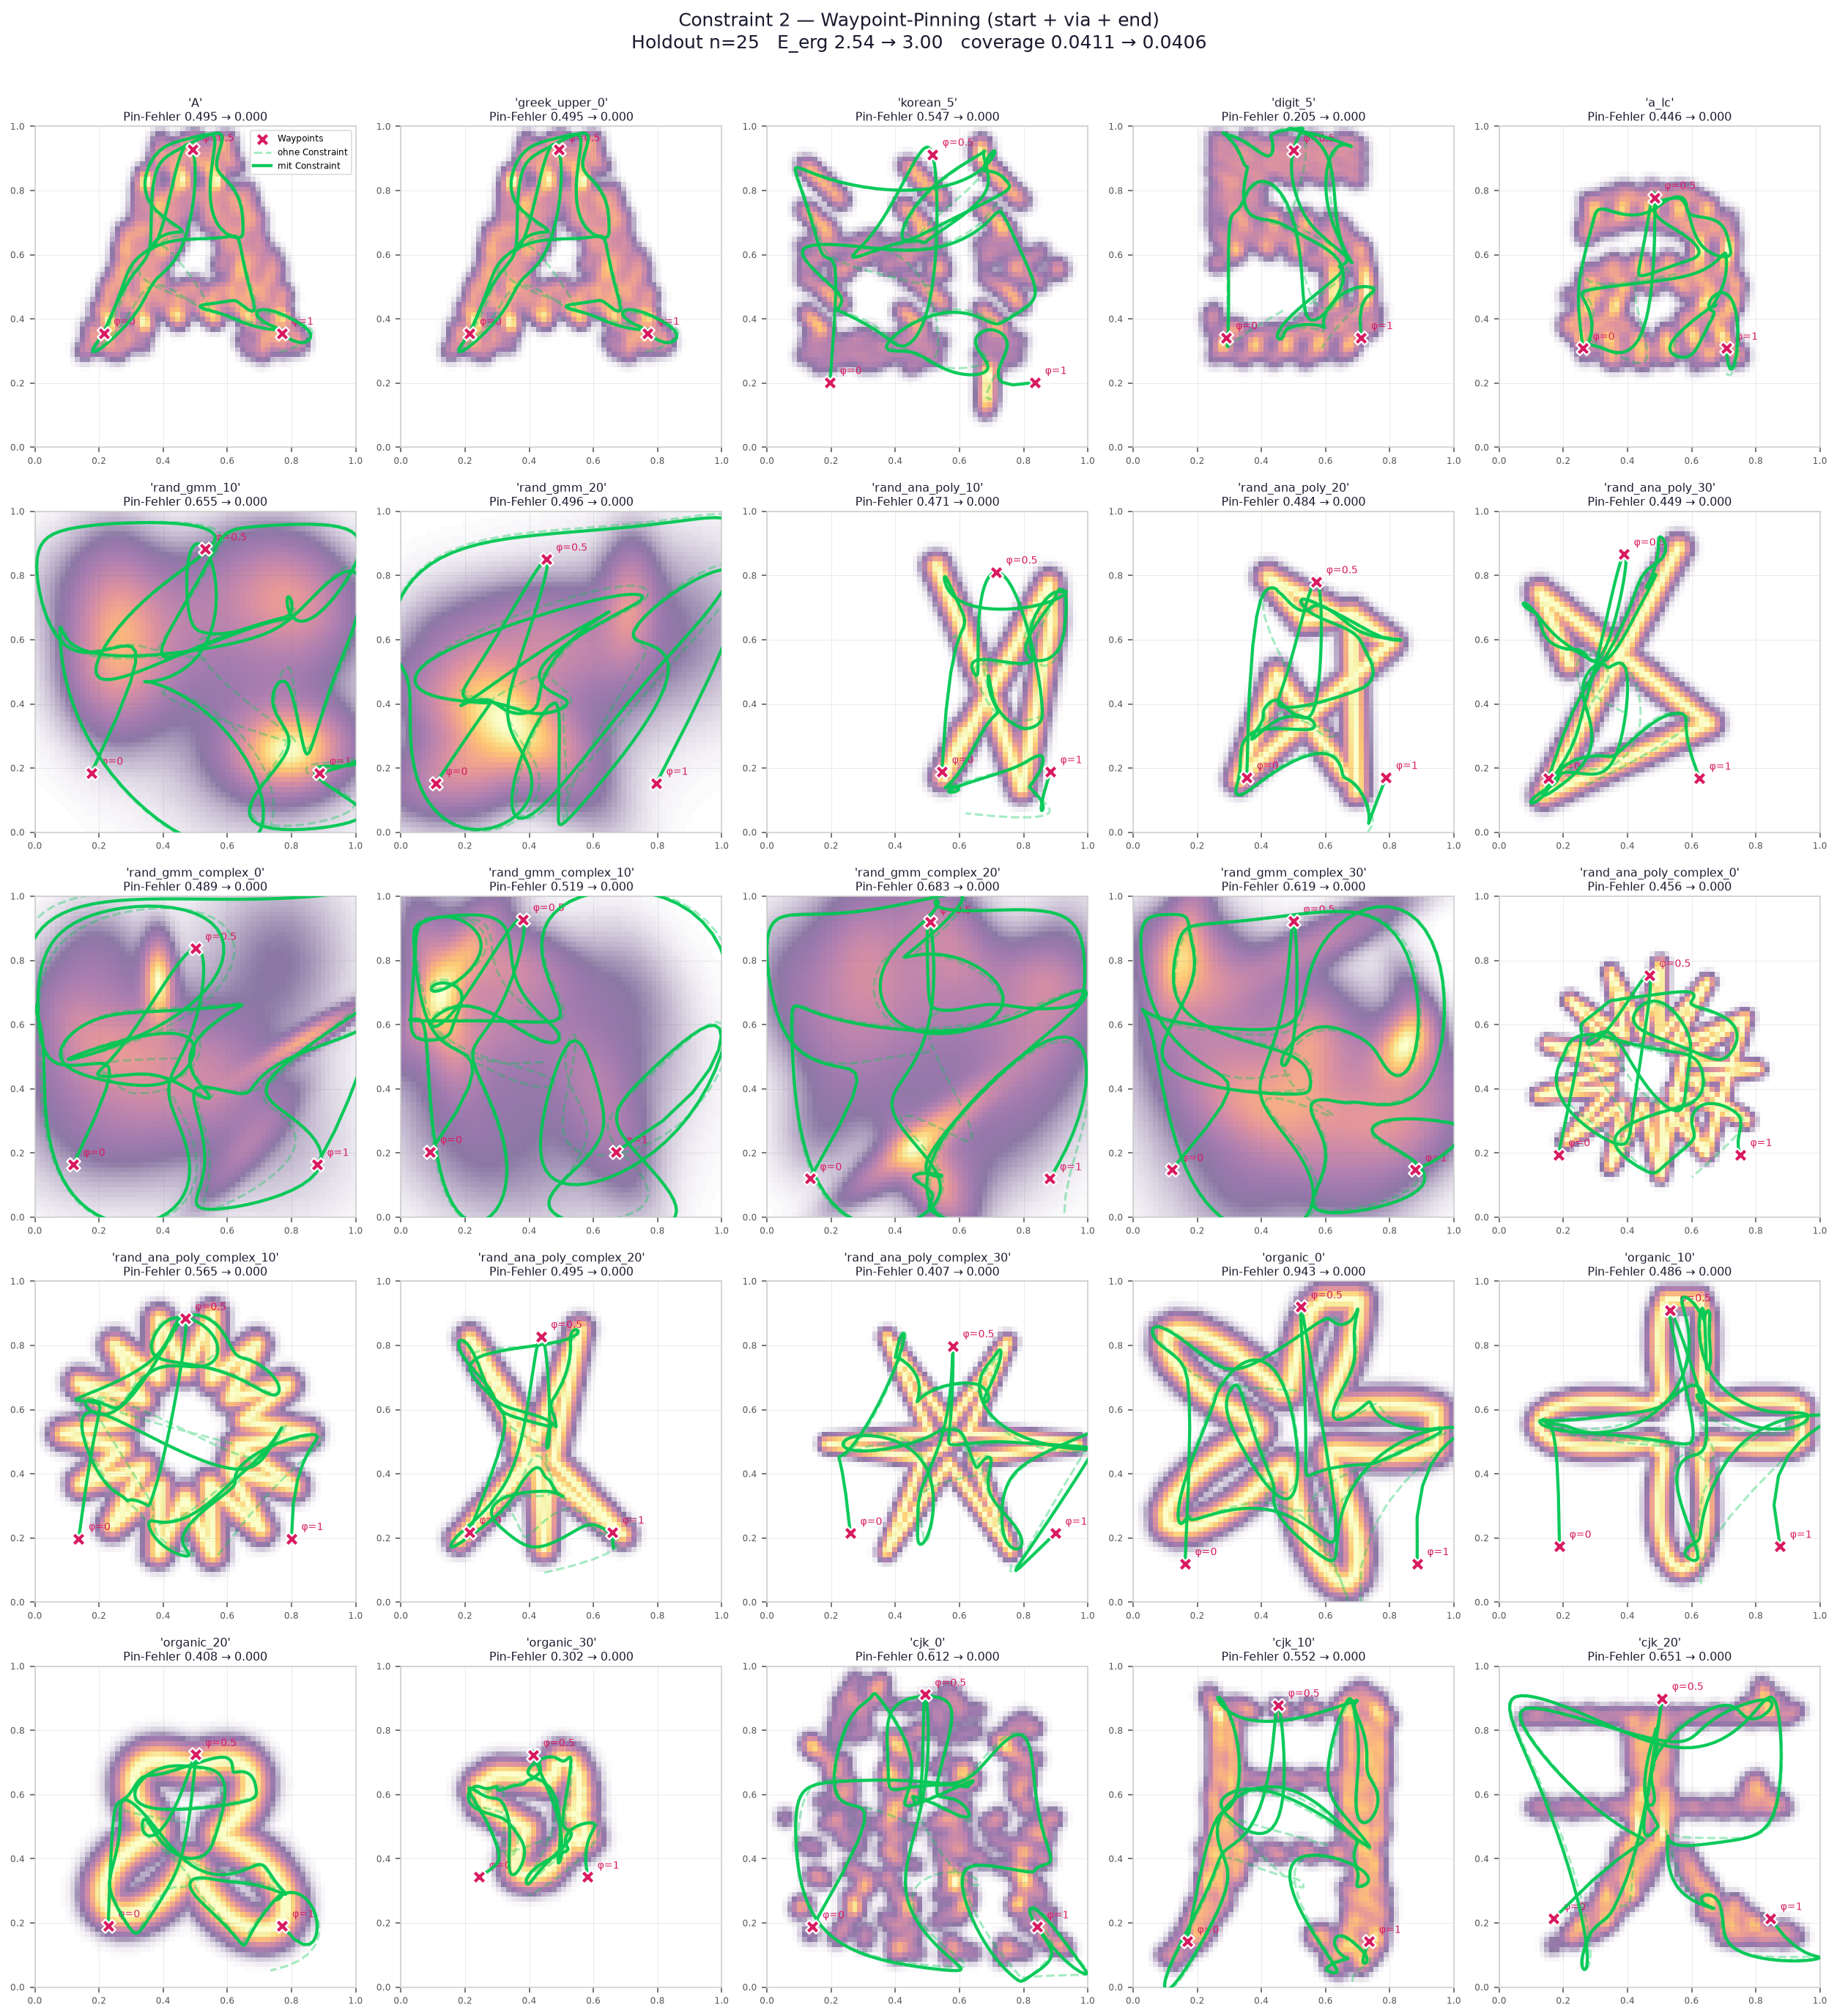
Constraints: Fix point contraint

Slide 5
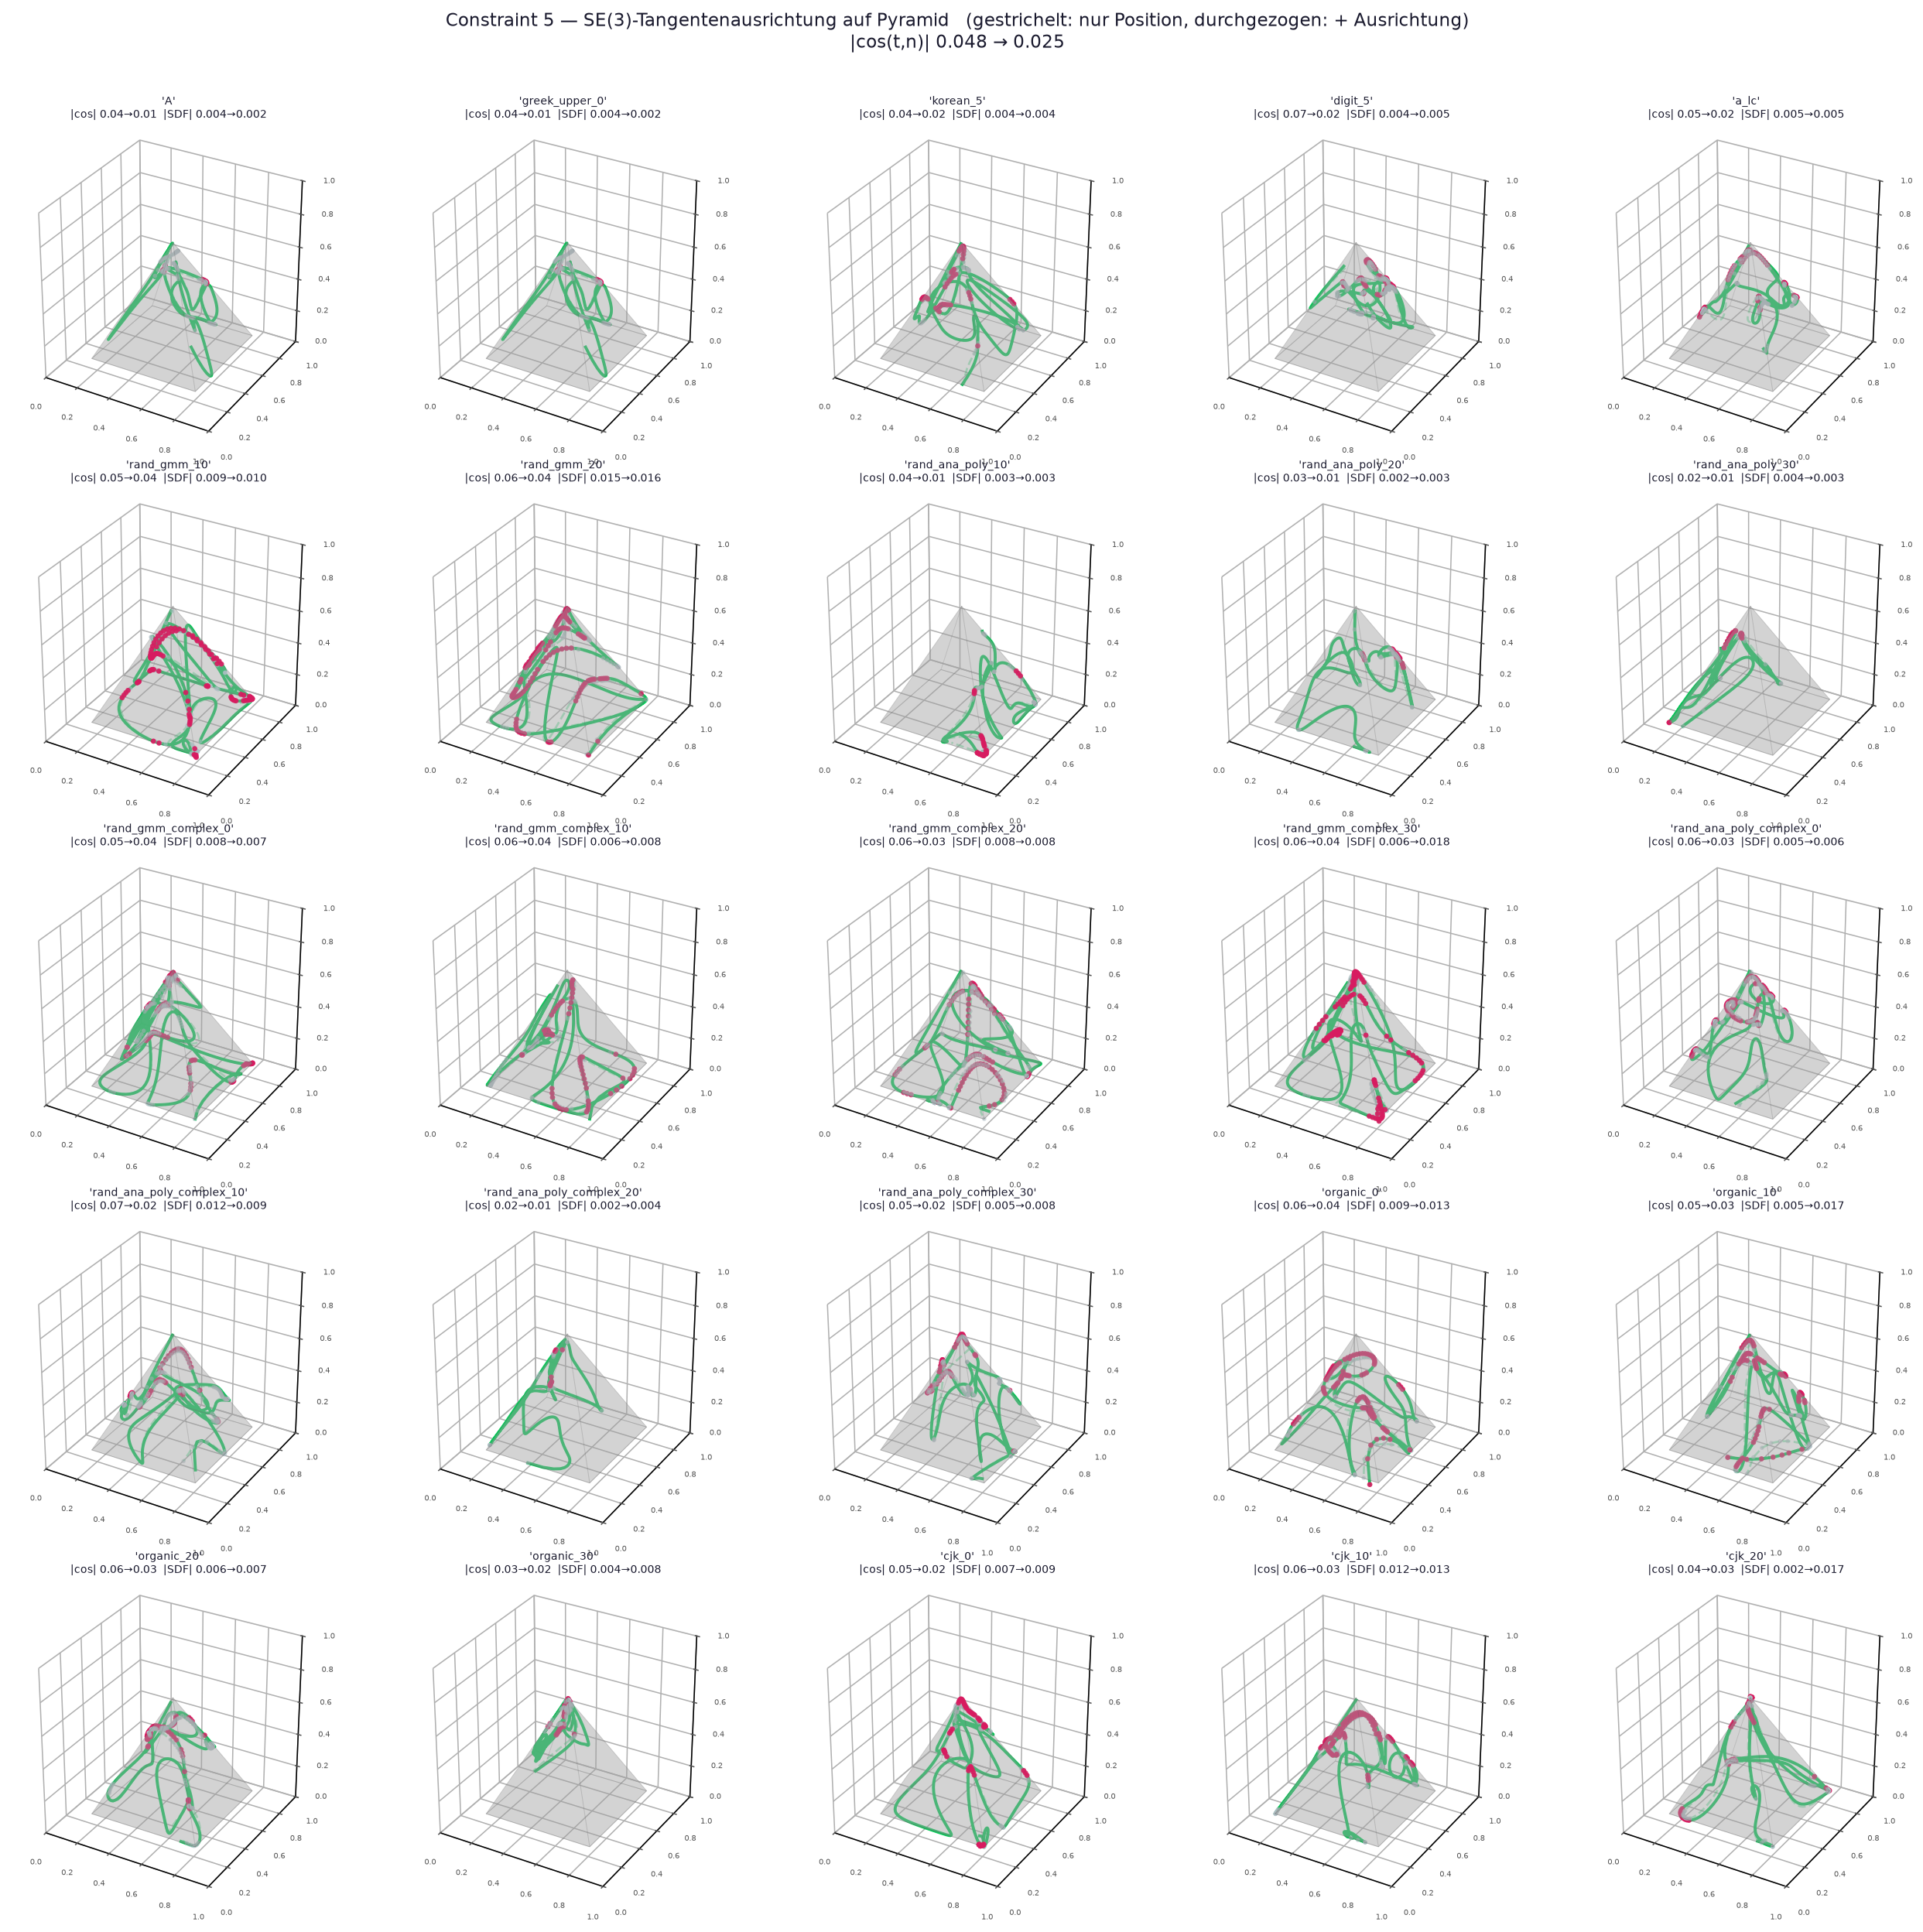
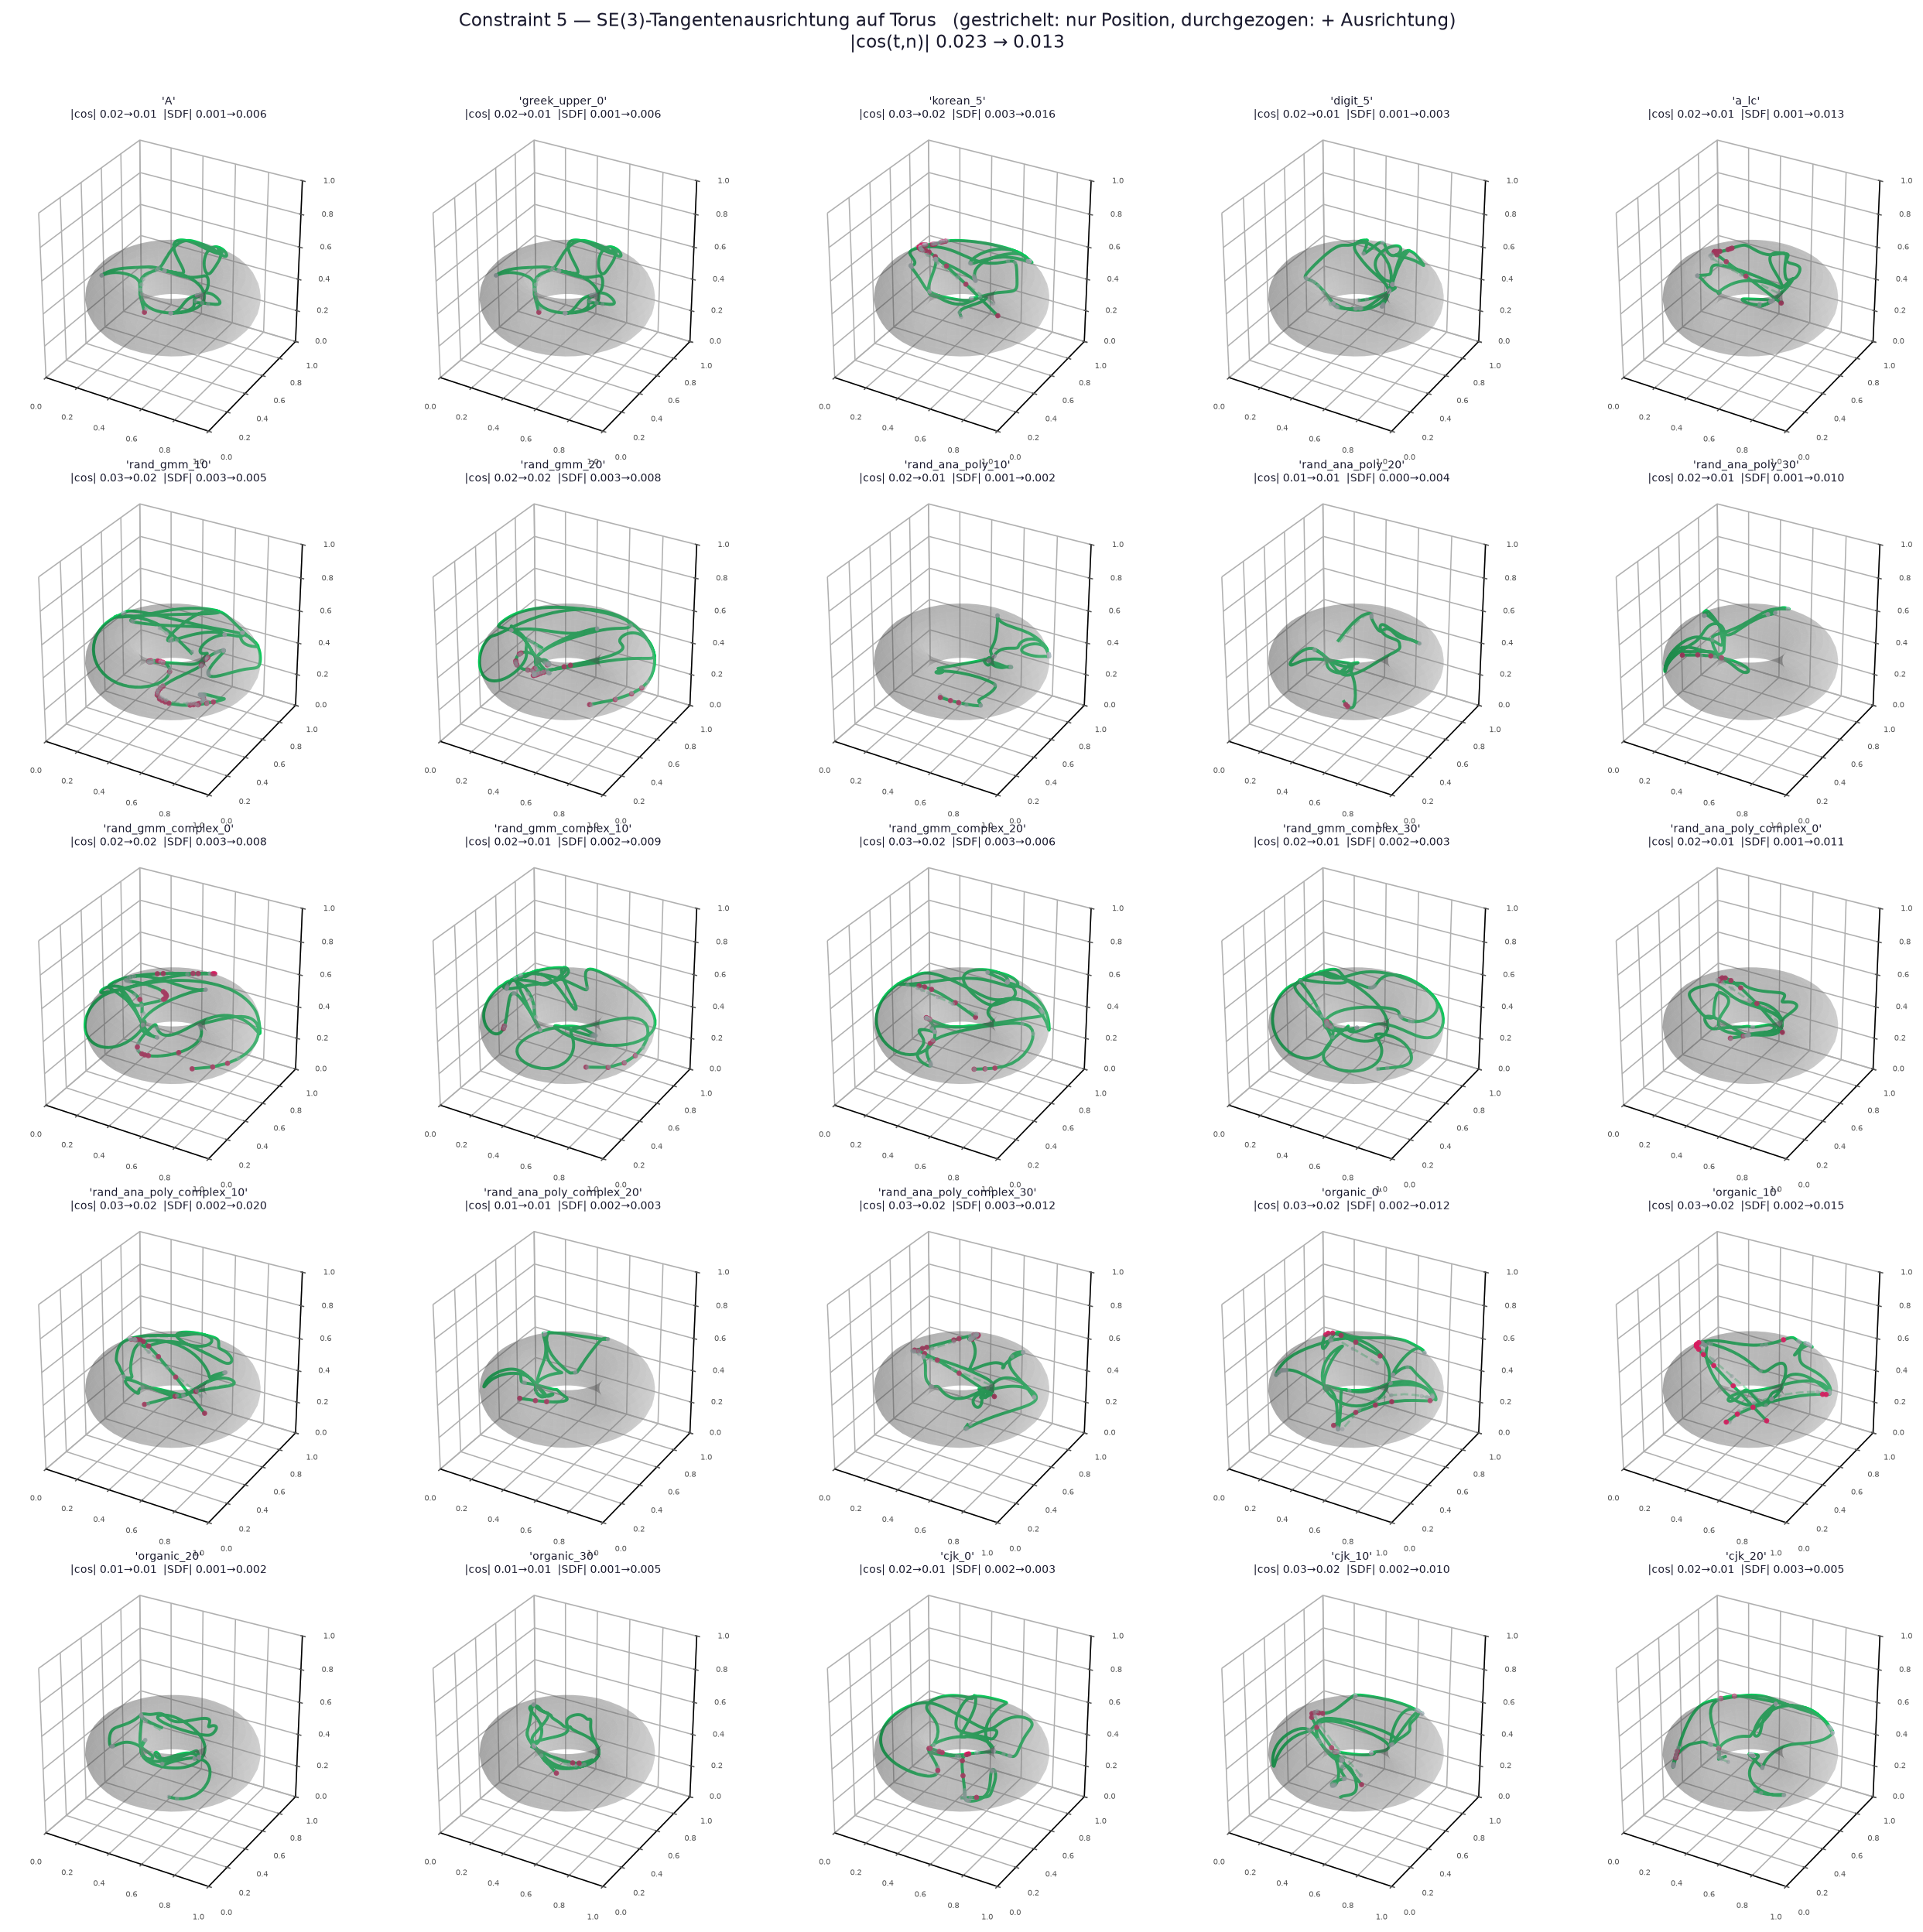
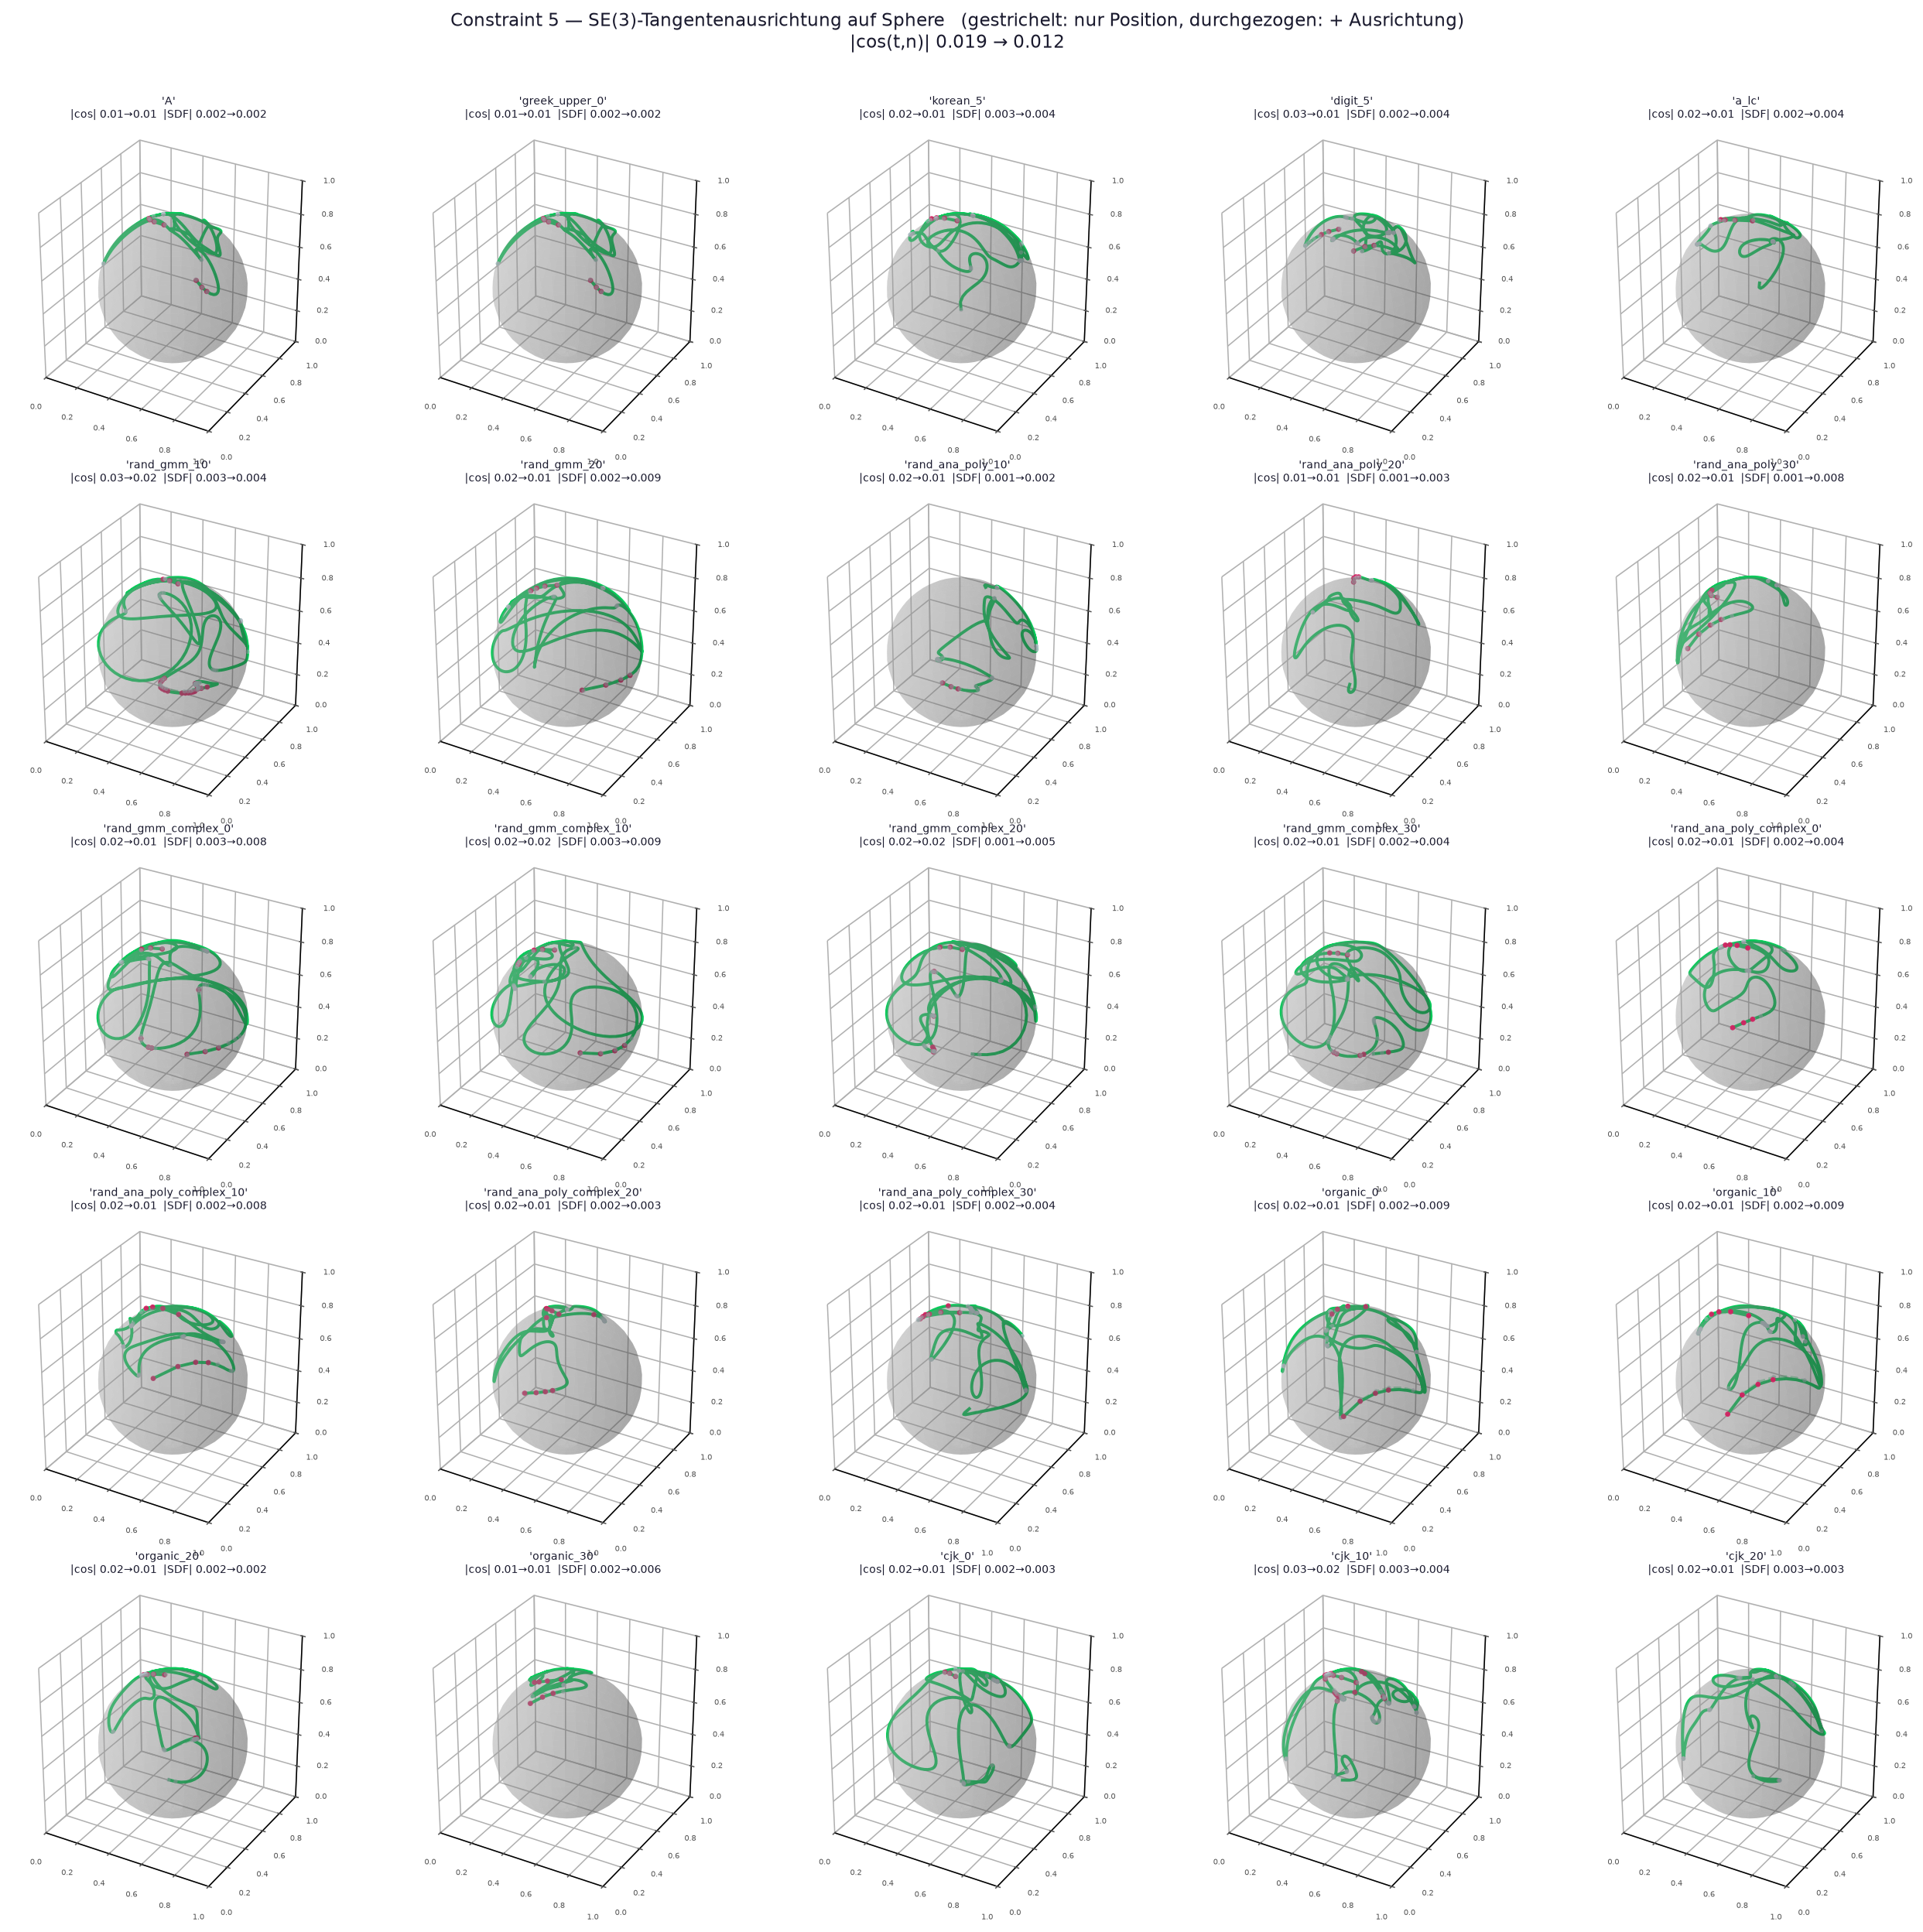
3D object penetration constraints

Slide 6
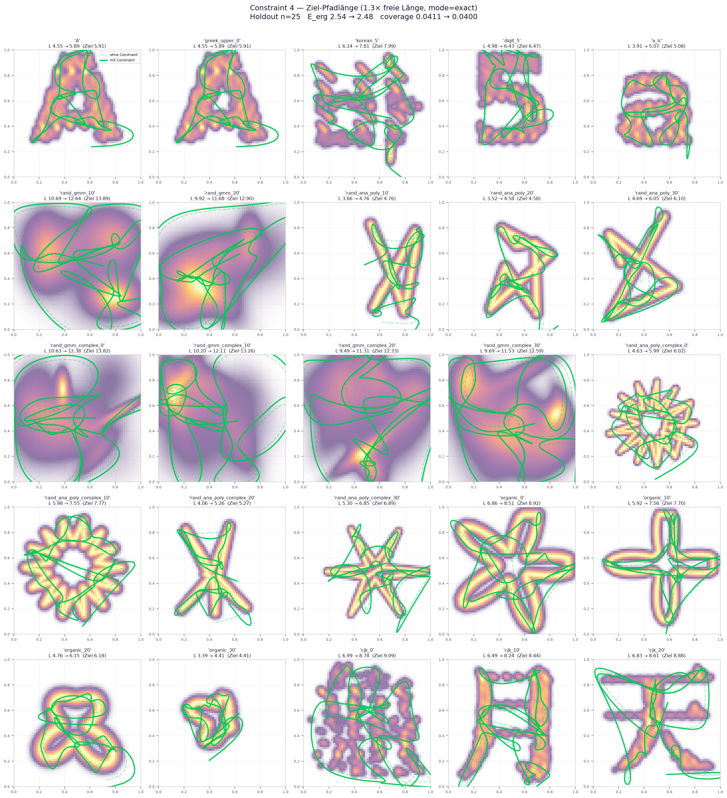
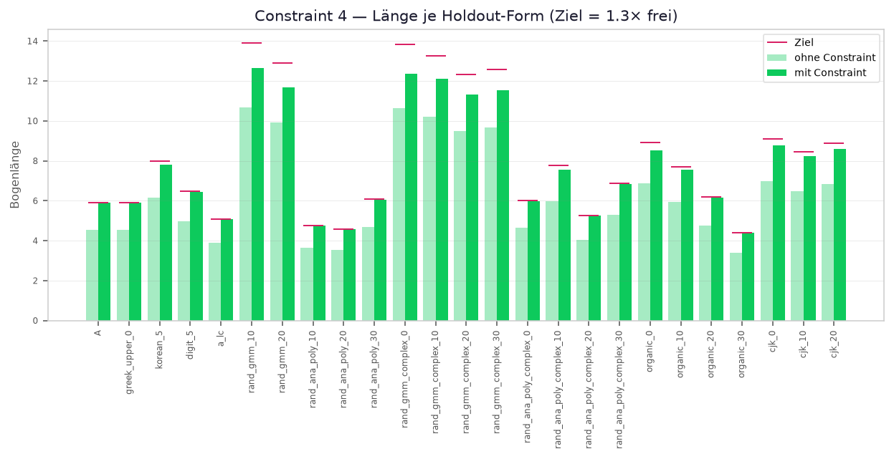

Length constraints - at inference

Slide 7
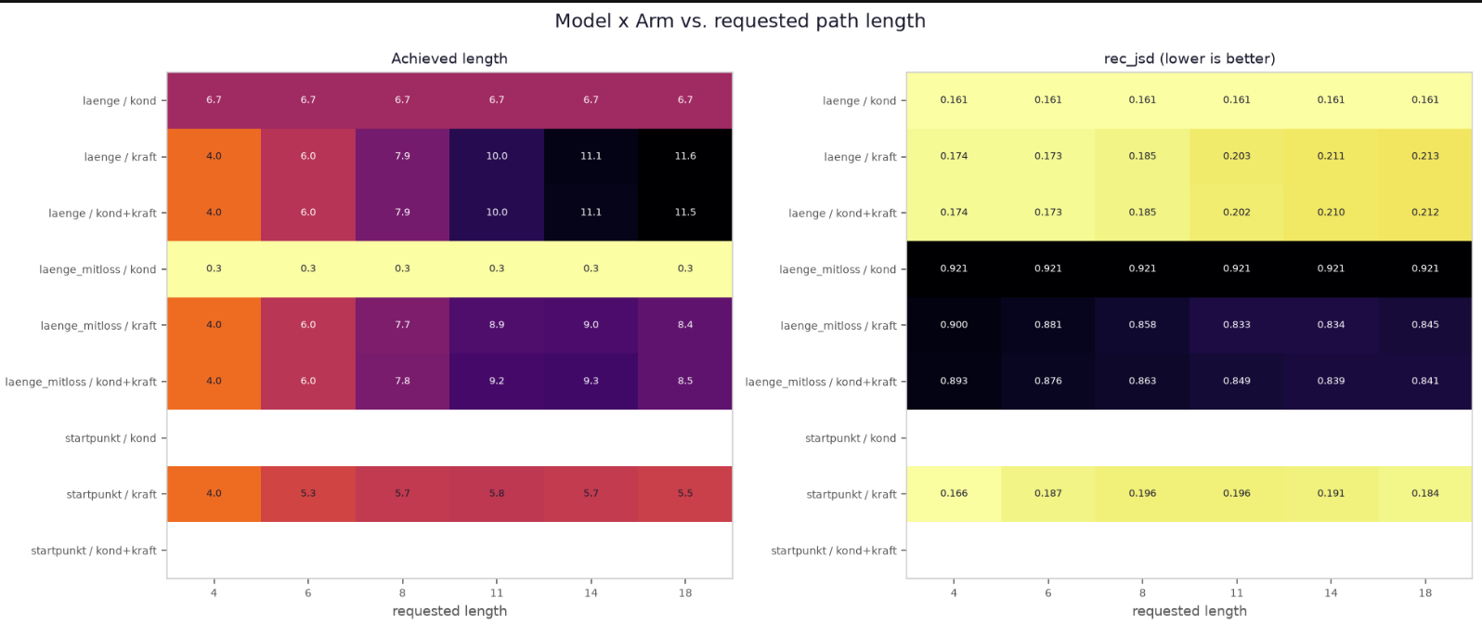
Length constraints - comparison to conditioning
Reconstruction Jensen-Shannon Divergence:

Slide 8
Exploration metrics
UCB (Upper Confidence Bound) Φ_UCB = μ + κ · σ
MASS Φ_MASS = (1 - w) · μ + w · σ
LSE Niveau Φ_LSE = P(f(x) > τ)
EID (Expected Information Density) EID(x) = (||∇μ||² + ||∇σ||²) / σ_noise²

Slide 9
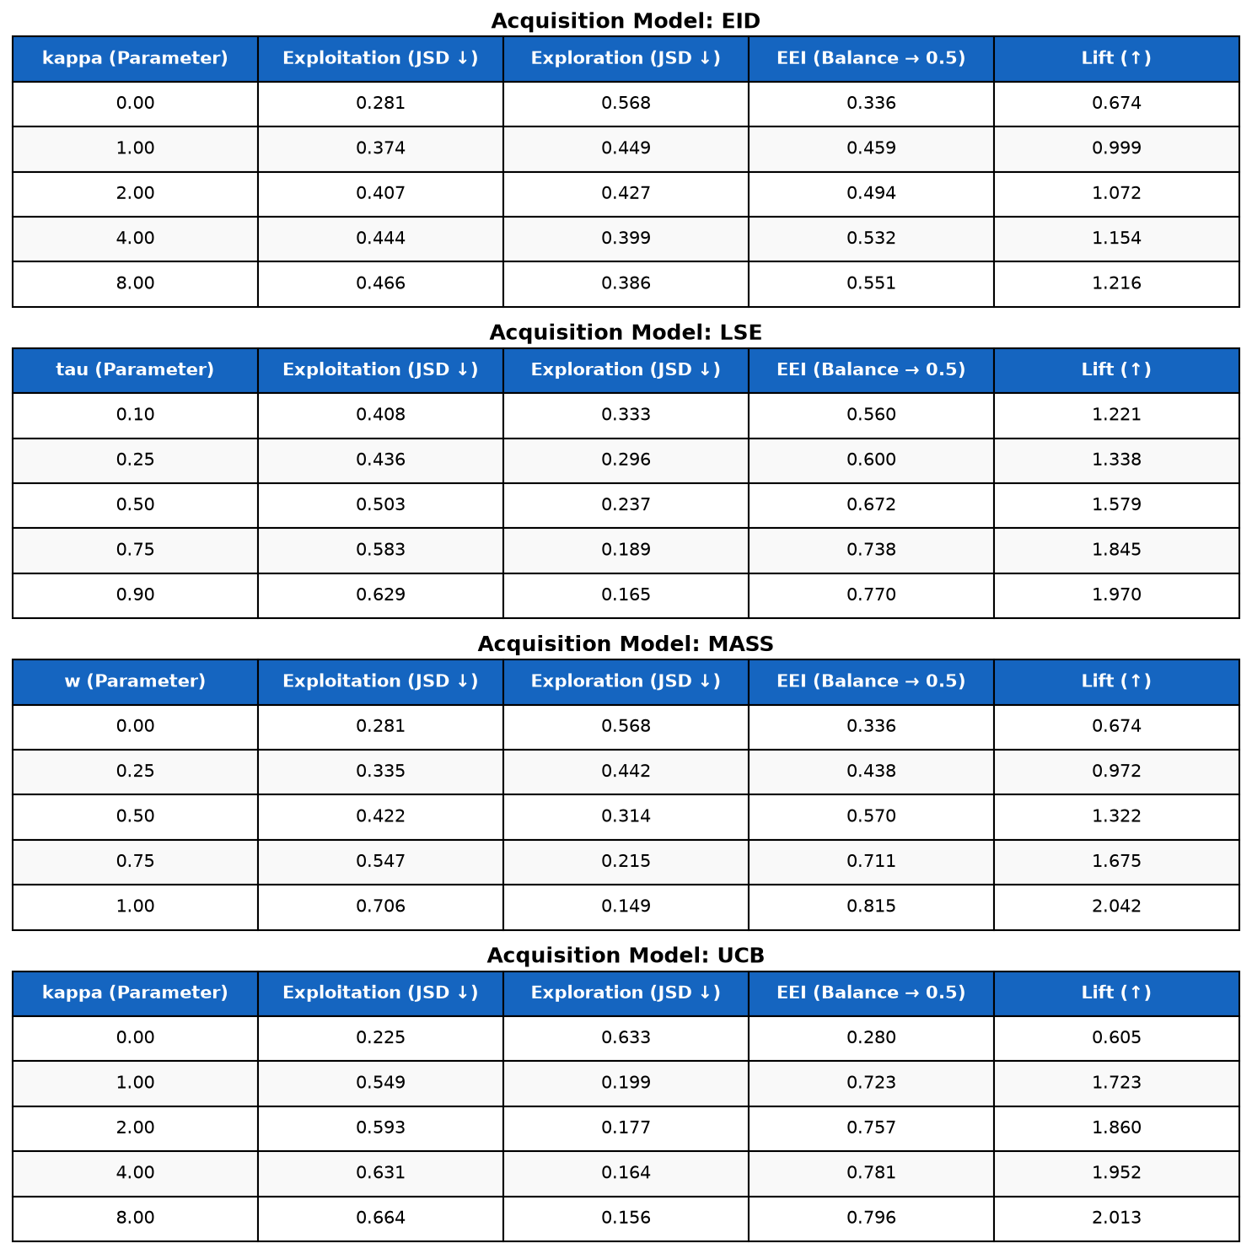
Exploration - table

Slide 10
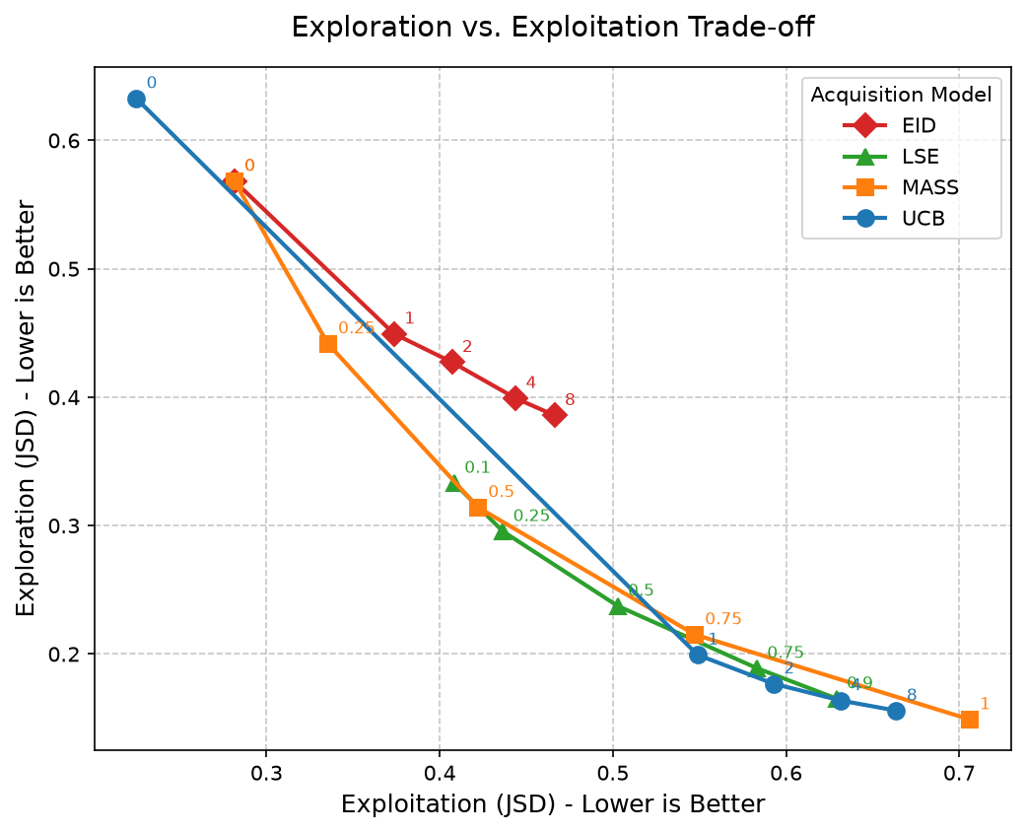
Exploration - graphs

Slide 11
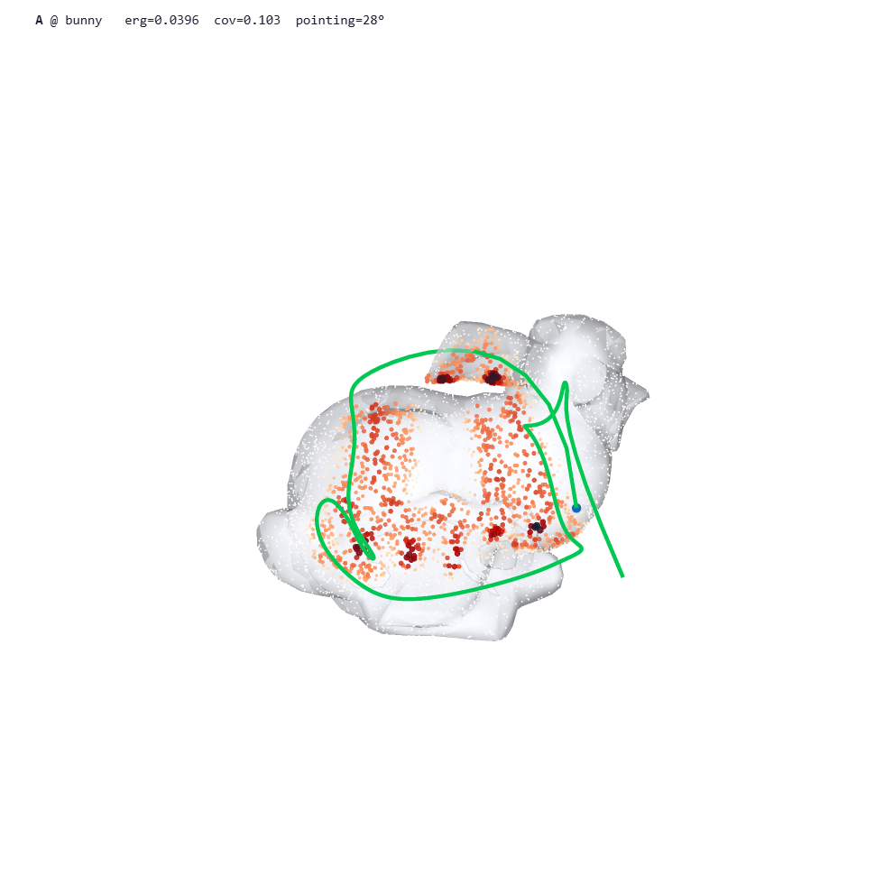
3D progress:
Extended the 3d database with 100 more shapes and started training, so far no real improvement, but training is still going

Slide 12
What kind of exploration
Similar direction as Ergosurf – Surface exploration
Similar direction as Asymptotically Optimal Ergodic Coverage on Generalized Motion Fields – Dynamic system exploration
Combination of both
Soft body exploration

Slide 13
Application scenarios
Solar panel repair will most likely have all necessary information, no exploration needed
Most robot arm setting make acquiring ground truth instead of exploration easy
Actual exploration: Underwater robotics, emergency robotics (fire mapping/exploration), exploration of damaged cities/buildings
How realistic should the scenario be? Do we need a scenario?

Slide 14
Other topics to discuss
Real robot experiments? Are we there yet? We will need an experimentation setting
Thesis registration
Some general ideas for thesis advancements

Slide 15
Things to do next week
Length adaptation
Find a good setting and what exactly to show with the exploration
Prepare a lab experiment setup and test the setup in mujoco

